Slide 1
CS2106 Tutorial 10
File Abstraction

Slide 2
Q1
Concepts explanation

Slide 3
Q1
Explain the following concepts in your own words clearly; the shorter, the better! Your explanation should be easily understandable for non-CS2106 students.
a) What is a file?
It is a named collection of data, used for organizing secondary storage.

Slide 4
Q1
Explain the following concepts in your own words clearly; the shorter, the better! Your explanation should be easily understandable for non-CS2106 students.
b) Name and describe some classifications of files.
Regular files: contain user information
Directories: system file for FS structure
Special Files: character/block oriented

Slide 5
Q1
Explain the following concepts in your own words clearly; the shorter, the better! Your explanation should be easily understandable for non-CS2106 students.
c) Distinguish between a file type and a file extension.
A file type is a description of the information contained in the file.
A file extension is a part of the file name that follows a dot and can help identify the file type.

Slide 6
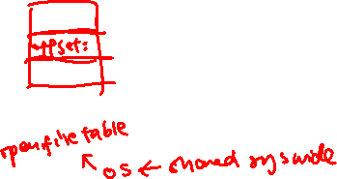
Q1
Explain the following concepts in your own words clearly; the shorter, the better! Your explanation should be easily understandable for non-CS2106 students.
d) What does it mean to open and close a file?
Operating systems keep a table of currently open files.
The open operation enters the file into this table and places the file pointer at the beginning of the file.
The close operation removes the file from the table of open files.

Slide 7
Q1
Explain the following concepts in your own words clearly; the shorter, the better! Your explanation should be easily understandable for non-CS2106 students.
e) What does it mean to truncate a file?
Truncating a file means that all the information on the file is erased but the administrative entries remain in the file tables. Occasionally, the truncate operation removes the information from the file pointer to the end.
Linux truncate helps to shrink or extend the size of a file to a defined size – can read up man page

Slide 8
Q2
Understanding directory permission

Slide 9
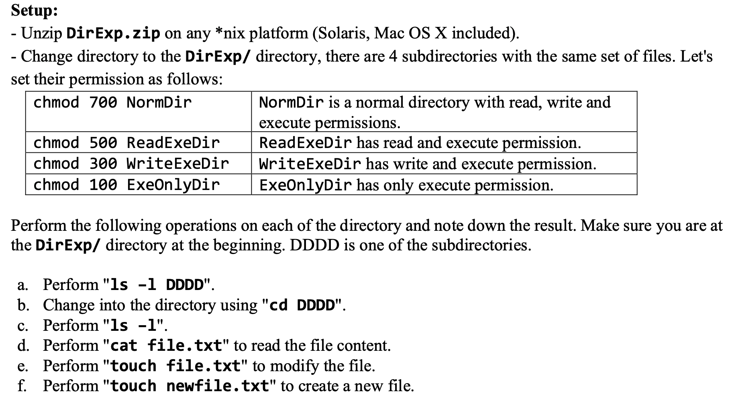
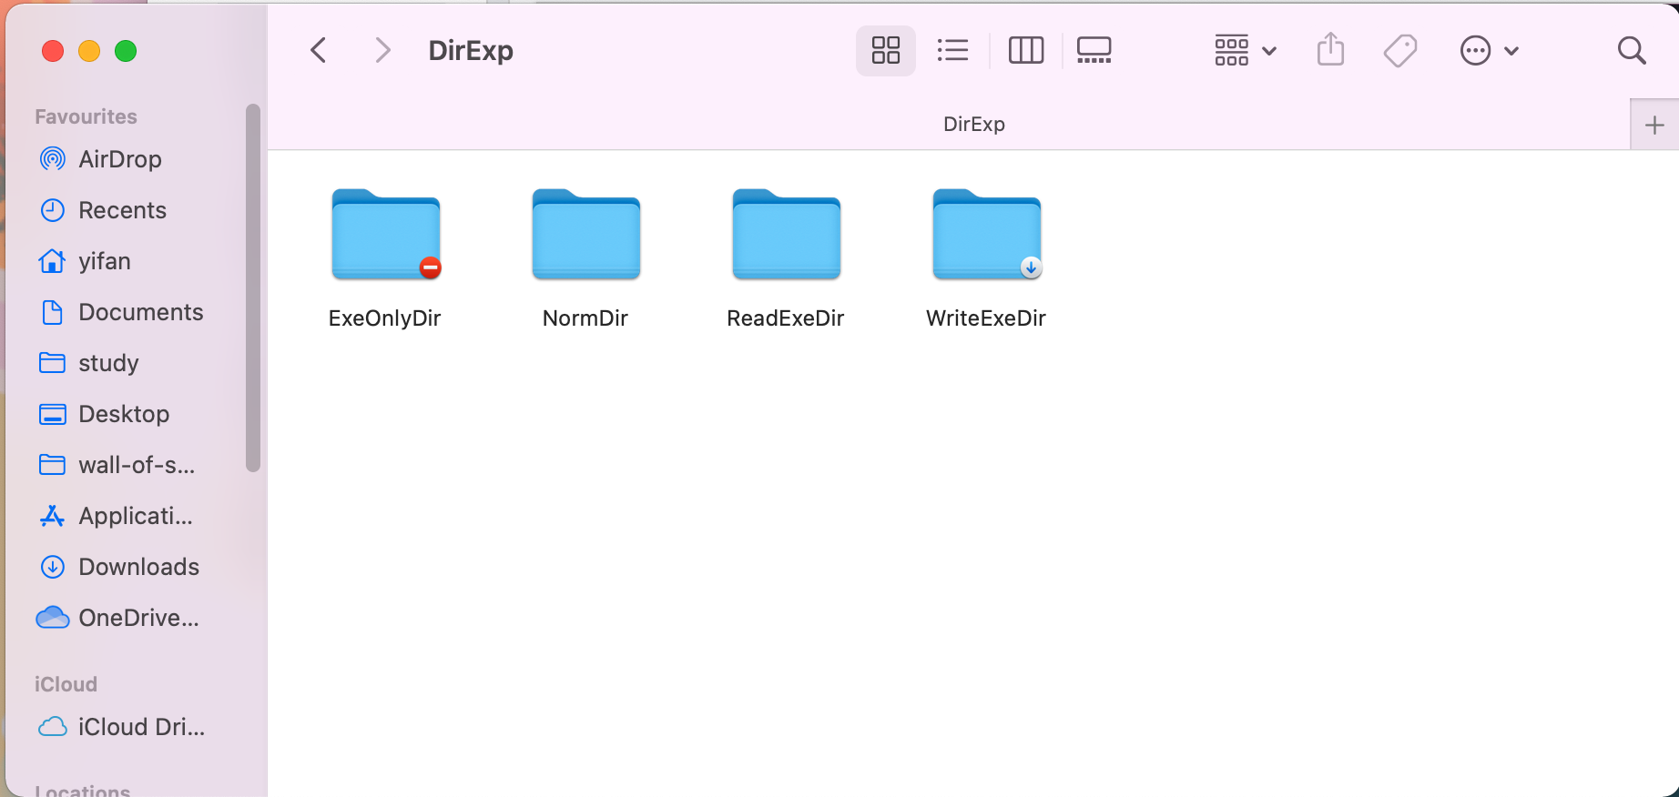
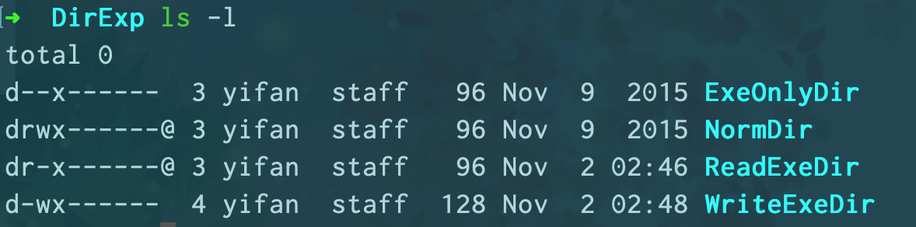
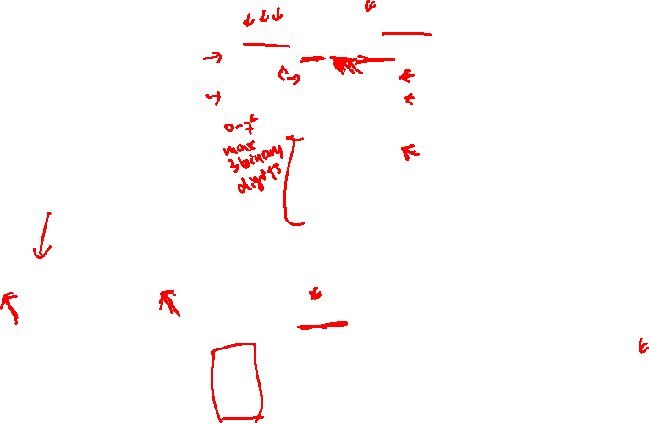
Q2

Slide 10
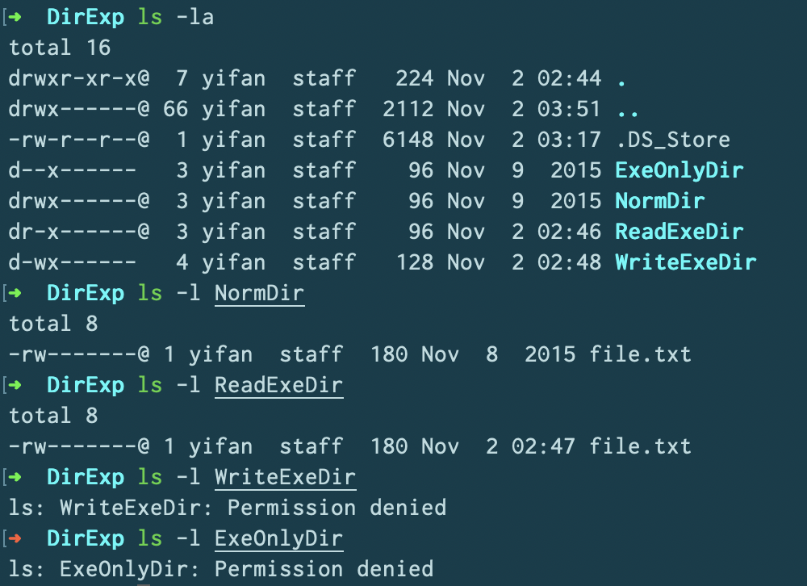
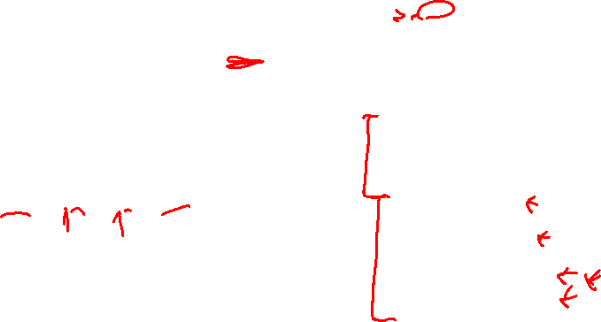
Q2

Slide 11
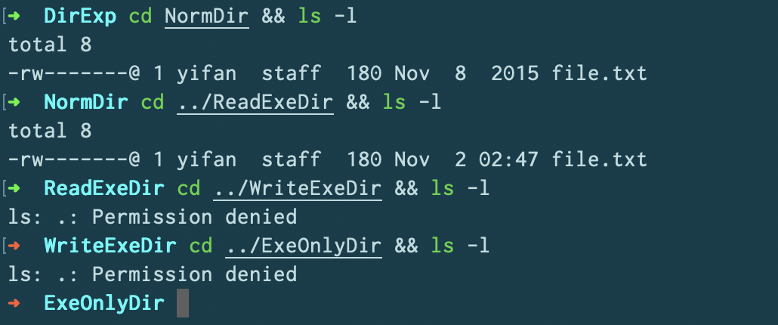
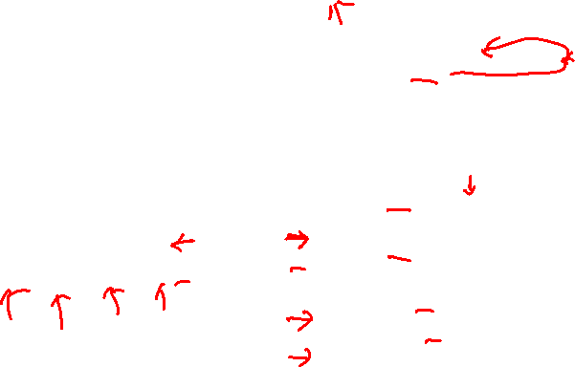
Q2

Slide 12
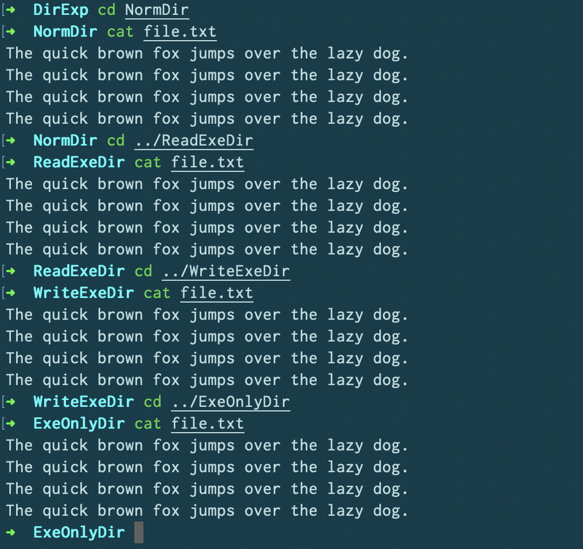
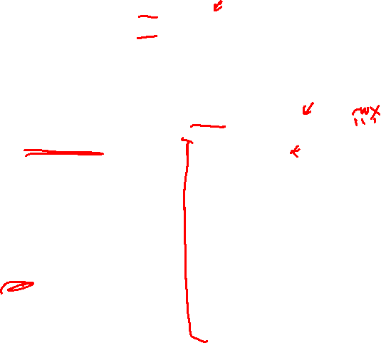


Q2

Slide 13
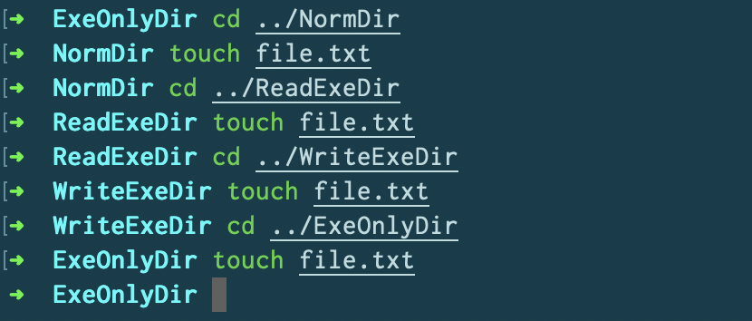

Q2

Slide 14
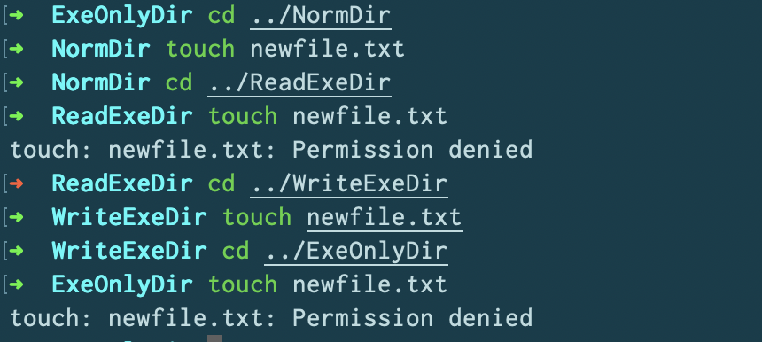

Q2

Slide 15

Q2
Directory == the list of directory entries (file/subdir)
Read = Can you read this list? (impact: ls, <tab> auto-completion)
Write = Can you change this list? (impact: create, rename, delete file/subdir). Note the interaction with the execute permission bit.
Execute = Can you use this directory as your working directory? (impact: cd ).
Since modifying the directory entries (i.e. with write permission) requires us to set the current working directory, execute bit is needed for the write-related operations under the target directory.
Directory permission is independent from the file permission. So, you still can modify a file under a "read only" directory if the file allows write.
If you want to allow outsider to access a particular deeply nested file, e.g. A/B/C/D/file, you only need execute bit on A, B, C, D directory (i.e. read permission is not needed). This is a great way to hide the content of the directory and only allow access to specific file given the full pathname.

Slide 16
Q3

Slide 17
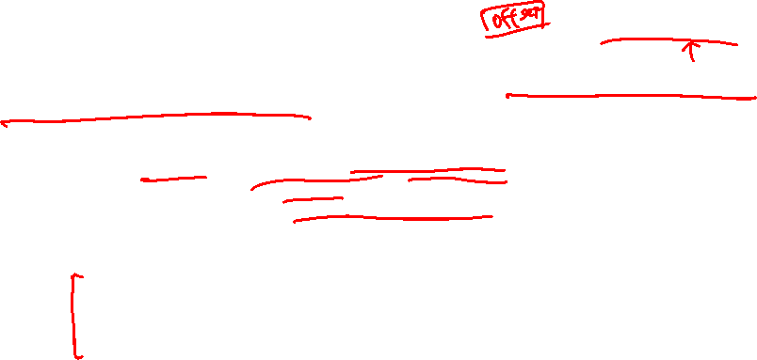
Why do many operating systems have a system call to “open” a file, rather than just passing a path to the read or write system calls each time ?
When read/write system take in a path to read/write each time.
we would incur the cost of permission checking and path resolution each and every time the system call is made, which are non-trivial and expensive.
Also, we lose the ability to have the OS track our offset within the file.
An interface like above would not generalise well to file descriptors that do not come from paths on the filesystem, like pipes and anonymous sockets.
Some history: open, read, write and close were present in the original Unix OS from the start. Although pipes and sockets, etc., didn’t come around until much later, the design generalised well to those. See https://unix.stackexchange.com/a/265627 , http://www.read.seas.harvard.edu/~kohler/class/aosref/ritchie84evolution.pdf

Slide 18
Q4
Wrapping File Operations

Slide 19
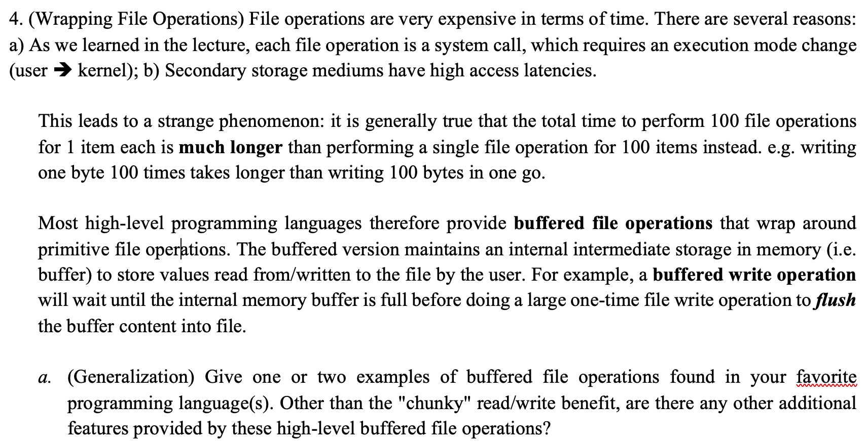
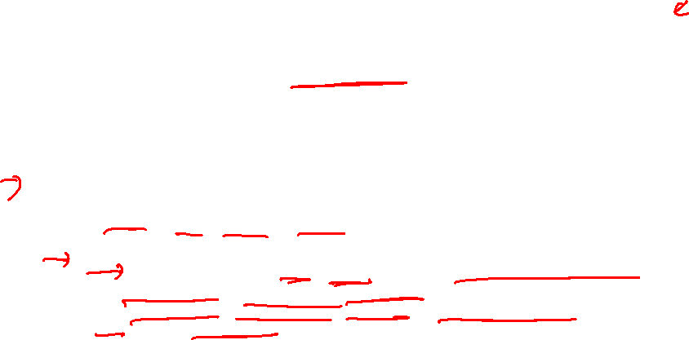
Common additional features:
error checking
packing/unpacking of datatypes (e.g. low level file operations are usually operating in bytes, it is useful to be able to directly operate on other datatype (int, float, etc) without worrying about how to translate the value into/from human readable string)
C: printf, scanf, fprintf, fscanf
printf and scanf are specifically to stdout and stdin, and are specialized versions of fprintf and fscanf. One can specify stdout/stdin as the file pointers. All of these are buffered.
The buffer is flushed when (i) full or (ii) fflush is called or (iii) new line character is read/written)
Java: BufferedReader/BufferedWriter, Scanner
BufferedReader/BufferedWriter have 8kB buffer while Scanner has 1kB buffer
C++: "<<", ">>" stream operators. Buffered.

Slide 20
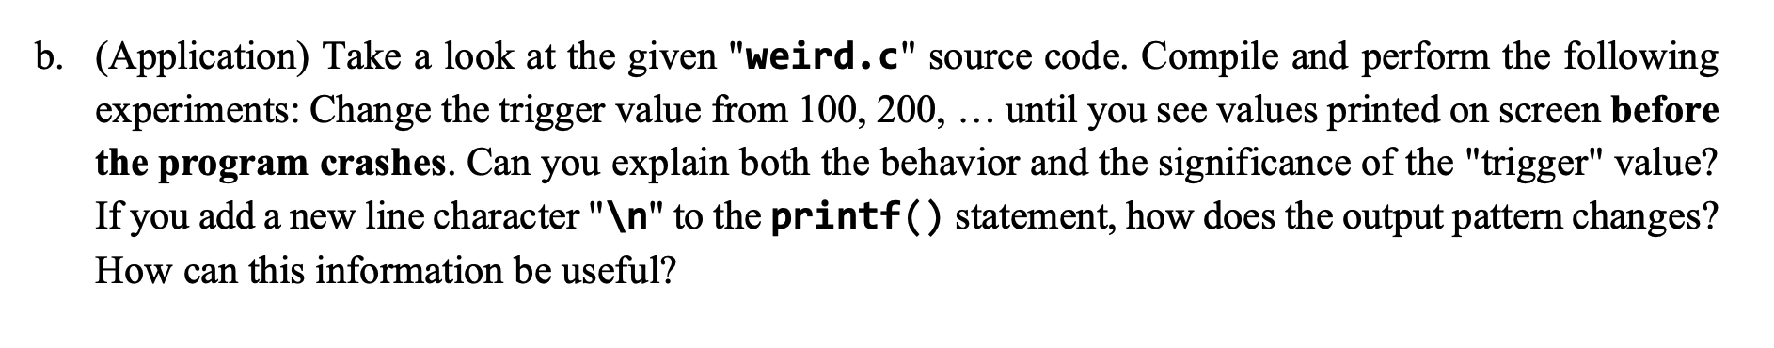
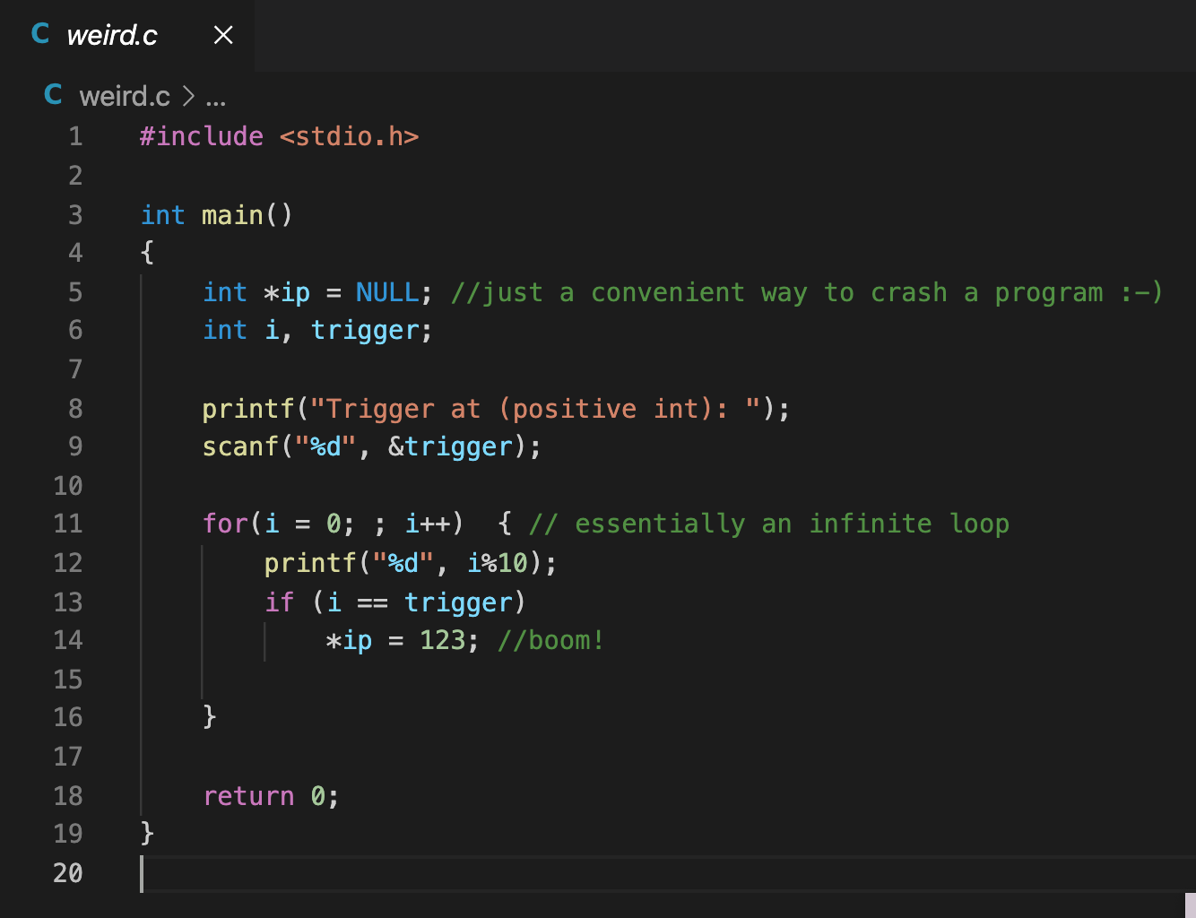
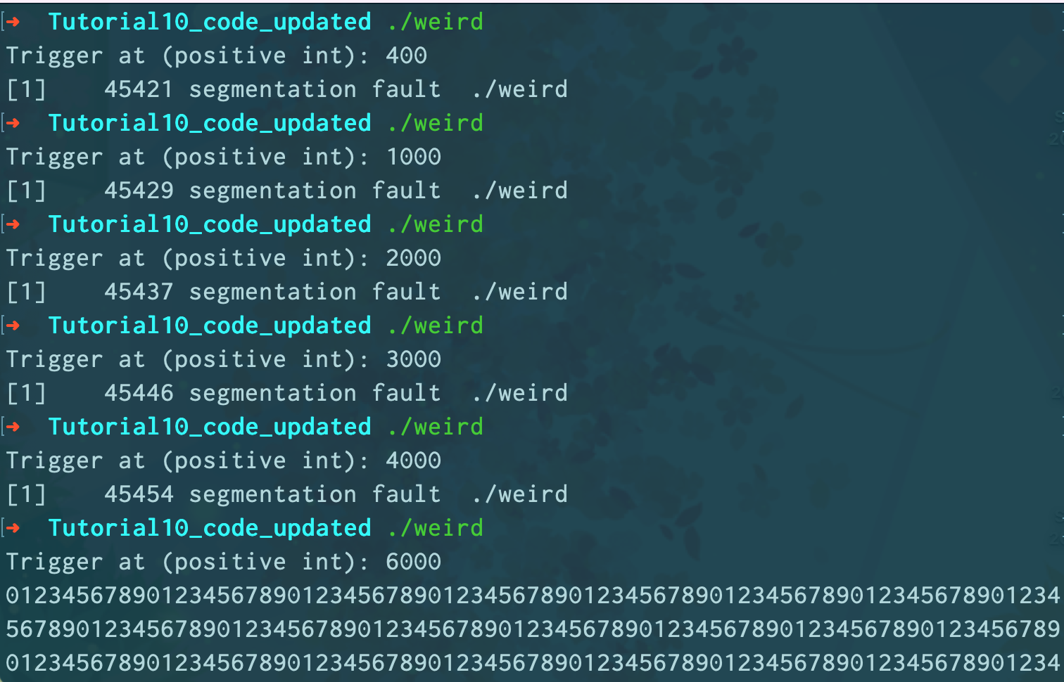
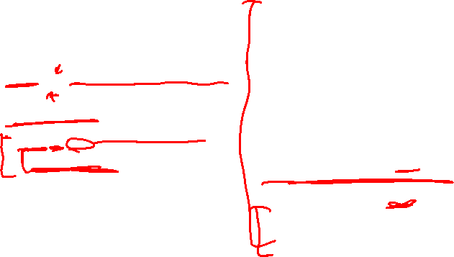

Slide 21
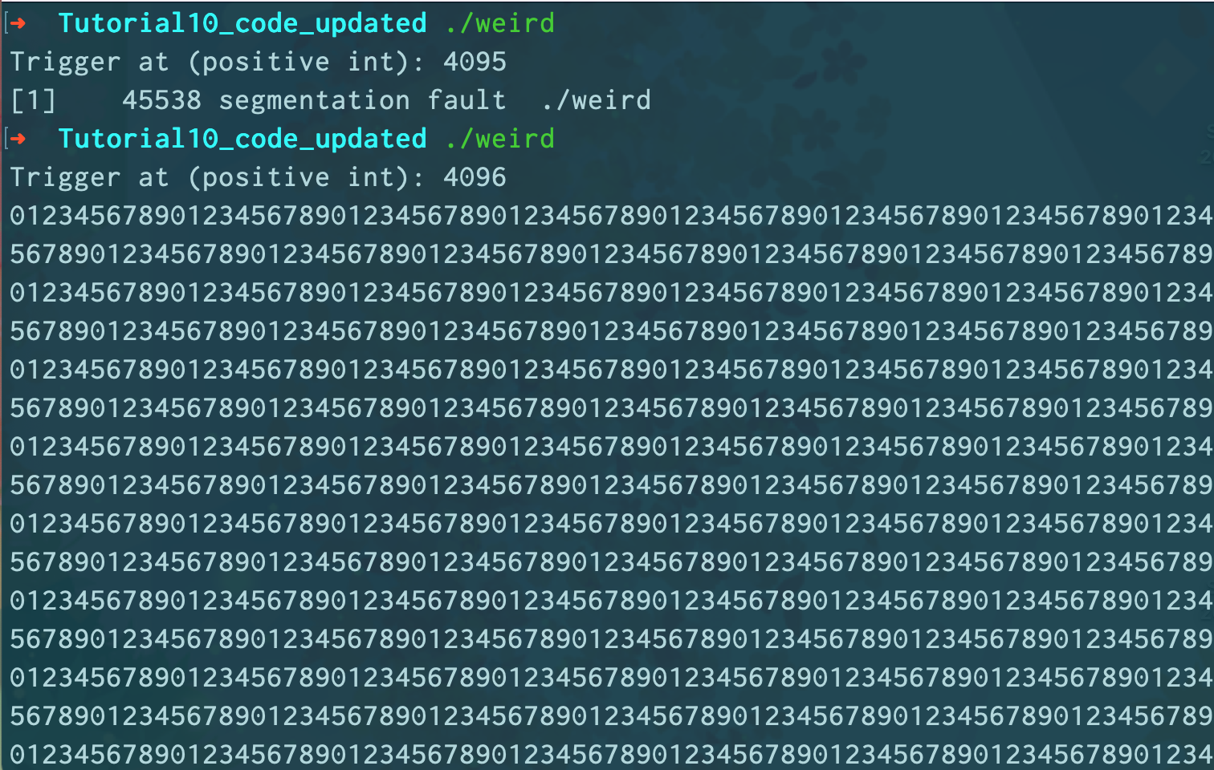

Slide 22
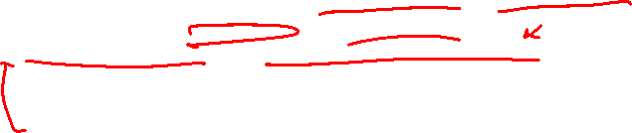
printf buffers the user output until the internal buffer is full before actually output to the screen.
The trigger indicates the probable size of the internal buffer.
If a newline character is added, the output is performed "immediately".
If printf() or similar is used as a debugging mechanism, the buffered output sequence may confuse the coder. e.g. in the original "weird.c", the program can crash without showing any printout, which can easily leads to the wrong conclusion ("the while loop is not executed!").

Slide 23
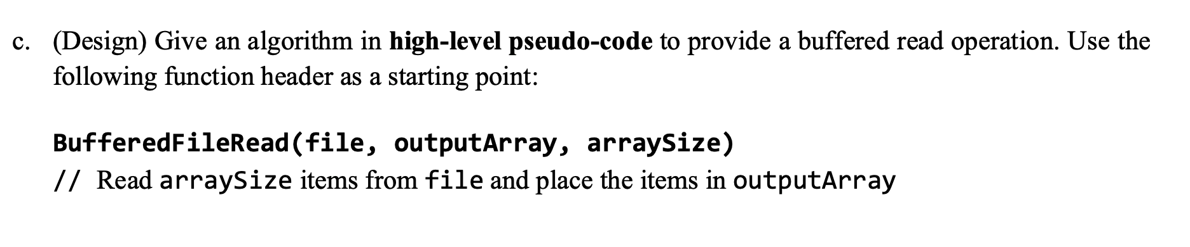
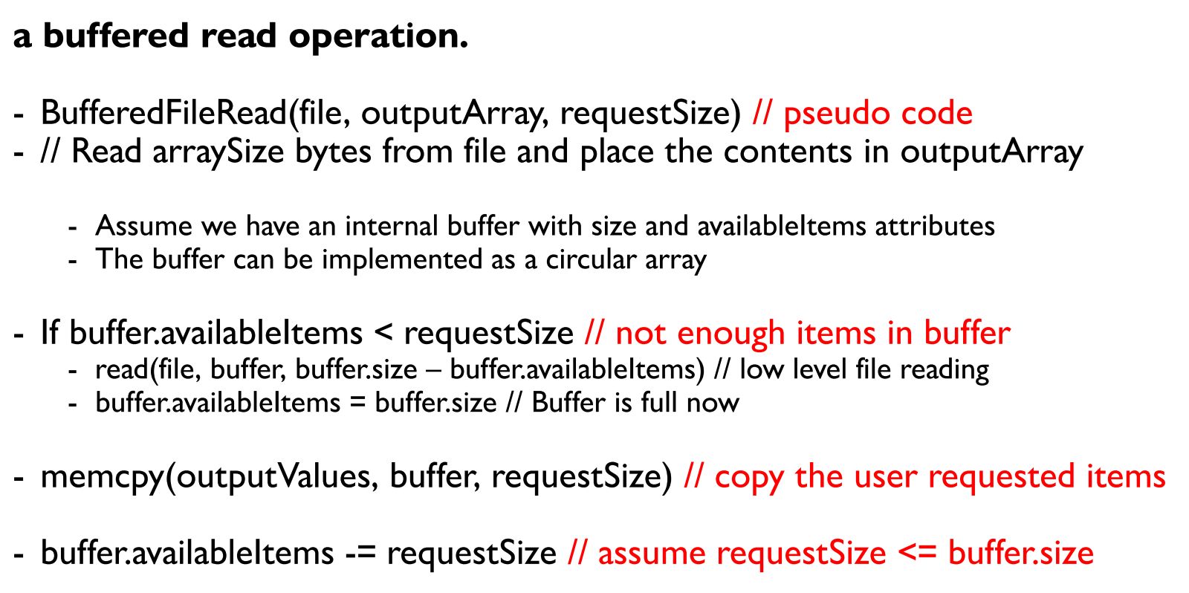
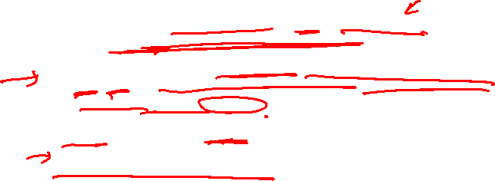

Slide 24


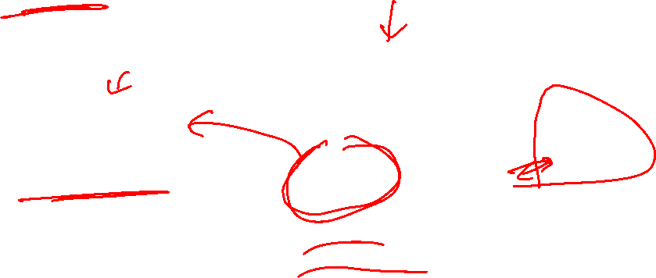




Slide 25
Q5

Slide 26
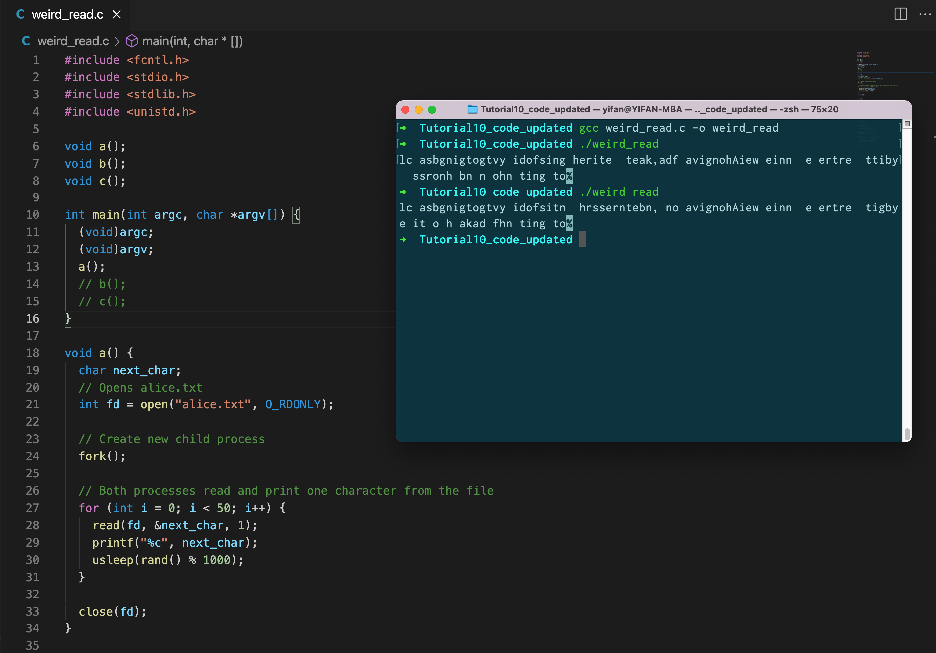



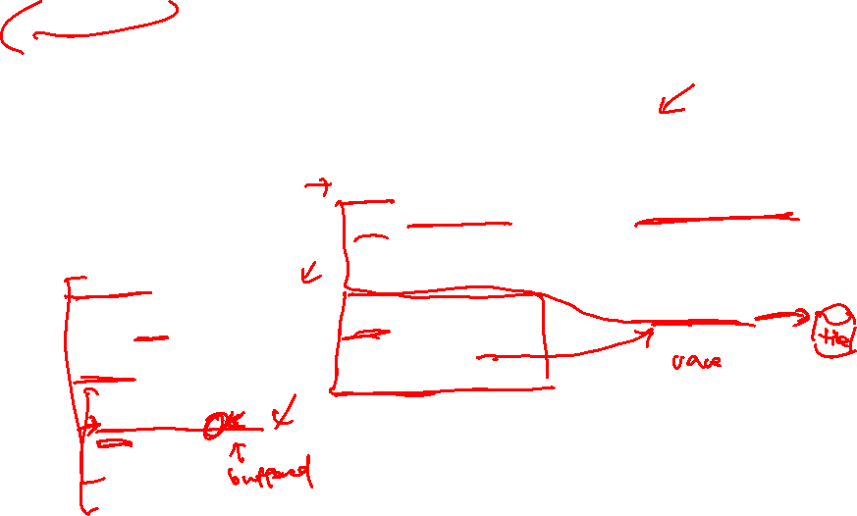

The characters are printed in a seemingly random order.
The file is opened once before fork, so the two processes’ file descriptors for alice.txt are pointing to the same open file table entry. When a process reads 1 character, the offset would be incremented, and the next read by either processes would be for the next character.

Slide 27

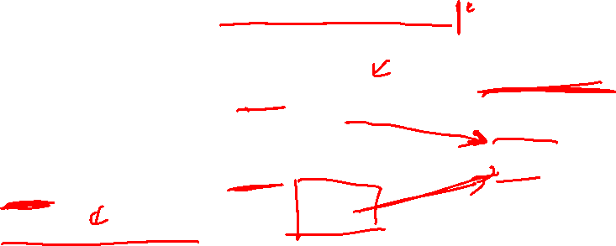


The first 50 characters of the text are printed in order two times.
As open is called after fork, each process’s file descriptor would point to different open file table entries. Therefore, the offsets which reads are called from are independent between the two processes

Slide 28
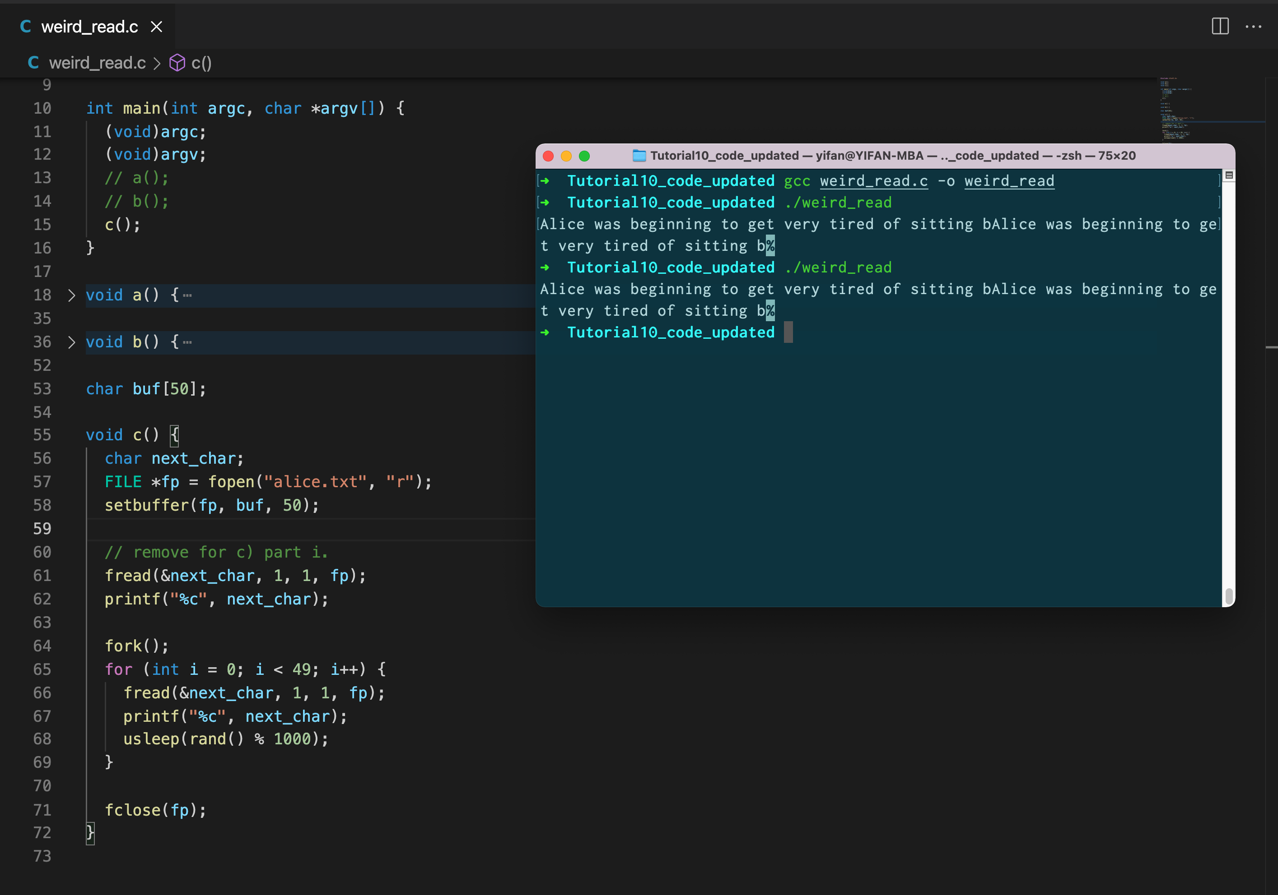


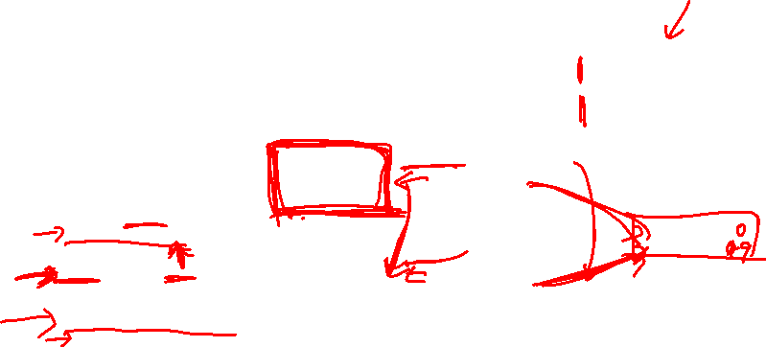


The first 50 characters of the text are printed in order two times (like b).
fread is a buffered IO operation (see 4c)), so it would read as much as its buffer can contain, but only copies to the caller’s buffer the number of bytes that the user requests. As the first fread is called before the fork, the filled buffer is copied to the child process. The child process then reads from this buffer until it consumes everything before it actually issues a file read.

Slide 29
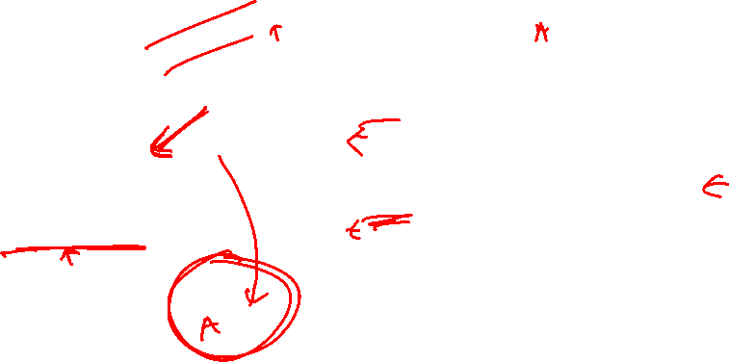


The first 50 characters of the text are printed in order two times (like b).
fread is a buffered IO operation (see 4c)), so it would read as much as its buffer can contain, but only copies to the caller’s buffer the number of bytes that the user requests. As the first fread is called before the fork, the filled buffer is copied to the child process. The child process then reads from this buffer until it consumes everything before it actually issues a file read.

Slide 30
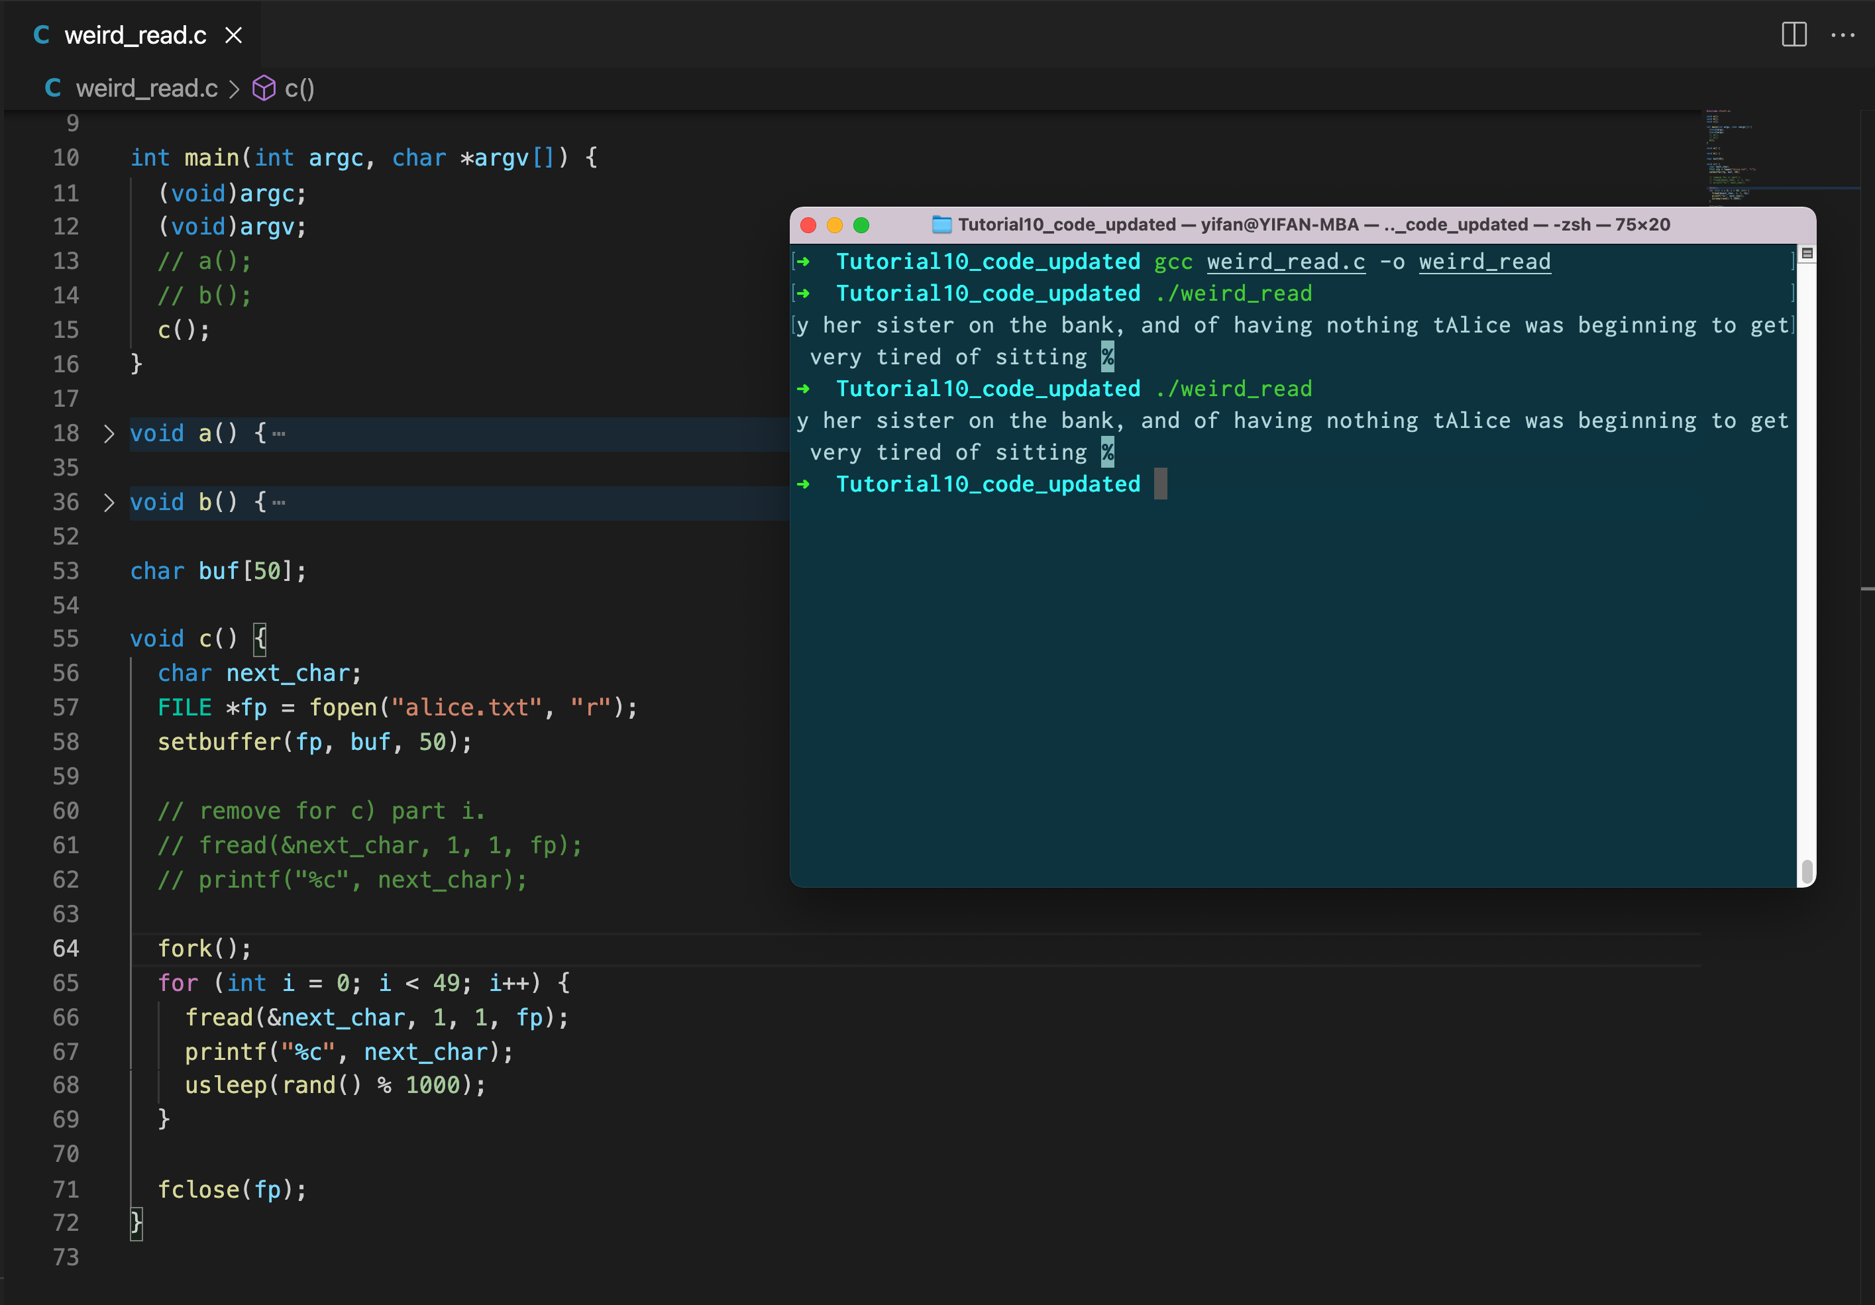

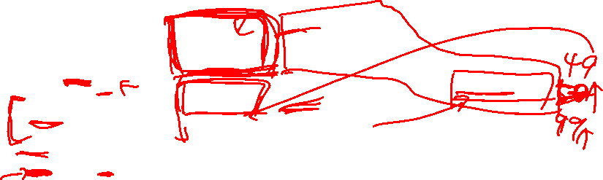
One process would print the first 50 characters, and the other would print the next (order can be either). As fopen is called before the fork, they are sharing a file descriptor like in a). But the underlying read syscall is called with buffer size = 50 instead, so every 50 characters read are not interleaved.

Slide 31
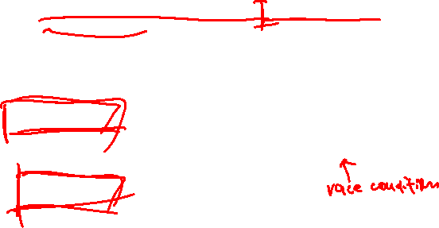

One process would print the first 50 characters, and the other would print the next (order can be either). As fopen is called before the fork, they are sharing a file descriptor like in a). But the underlying read syscall is called with buffer size = 50 instead, so every 50 characters read are not interleaved.

Slide 32

One process would print the first 50 characters, and the other would print the next (order can be either). As fopen is called before the fork, they are sharing a file descriptor like in a). But the underlying read syscall is called with buffer size = 50 instead, so every 50 characters read are not interleaved.

Slide 33

ii. What happens when c() is run with multiple threads instead of processes?
The read buffer is shared in process space, so an interleaving similar to (a) would be expected for fread calls. However, since the write buffer in printf to stdout is shared between both threads, the output to stdout will be interleaved as well. Hence, the interleaving behaviour may not be evident in most execution scenarios

Slide 34
Thank you!

